Slide 1
Run CNN+RayBNN on CCDB
Yuantao Tu
Notes:
Hi everyone, today I will be presenting on how to run CNN and RaybNN model training on Digital Canada. The presentation is based on Xuan's project code.

Slide 2
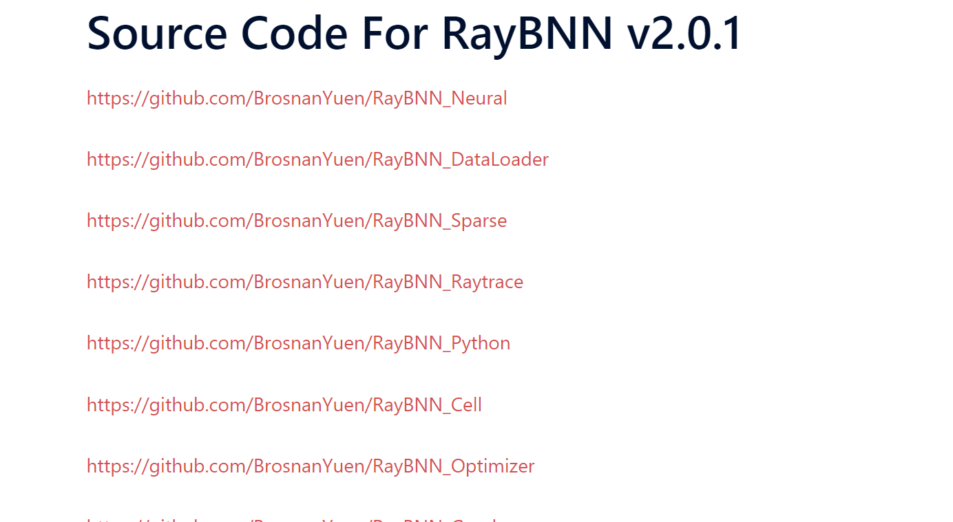
Package RayBNN_python
Git clone RayBNN_Python
Load necessary module(I add openblas)
Notes:
The first step is to clone Brosnan's RayBNN_Python repository from GitHub. This repository is used for developing Python wheels of RayBNN.
Next, we need to load all the necessary modules. Please note that I have added the OpenBLAS module.

Slide 3


Package RayBNN_python(cont.)
install dependencies in the virtual environment
use maturin to package Rust code into python wheel
Check that raybnn_python is installed successfully as python module
This process doesn’t need to be submitted to compute cluster
Notes:
Next, we need to create a Python virtual environment and install the necessary dependencies. After that, we will use Maturin to package the provided Rust code into Python wheels.
We can use the pip list command to check if raybnn_python is installed successfully. As you can see, there is a package called raybnn_python with version 0.1.2.
This process doesn’t need to be submitted to the compute cluster; you don't need to sbatch a script for this step. Submitting it to the compute cluster may result in errors.

Slide 4
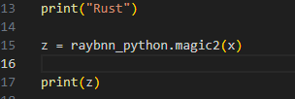

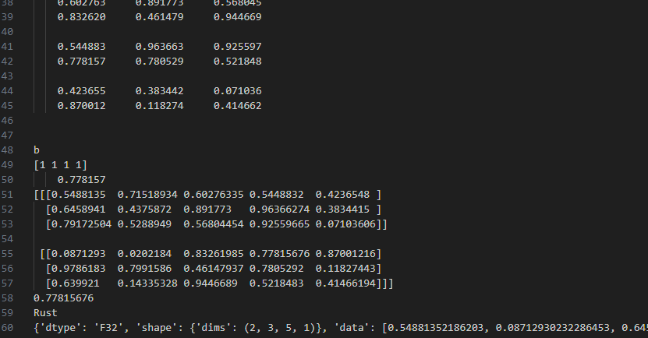
Package RayBNN_python(cont.)
Try RayBNN_Python/Rust_Code/example.py to validate raybnn_python package
Submit jobs to run example.py and ouput is shown above
Notes:
Brosnan also provides an example Python file to check the installation. This file imports the raybnn_python package and uses it.
To use raybnn_python, you need to submit jobs to the compute cluster. The output should look like this:

Slide 5
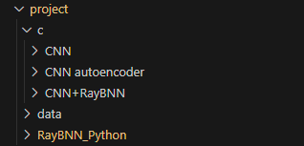

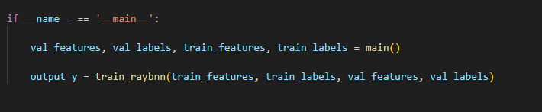
Try code from Xuan
Download code of Xuan and unzip it (using Globus to transfer it onto CCDB)
Try to run C/CNN Code
Use CNN model to extract features and labels
Then apply raybnn to train it
Notes:
I tried to run Xuan’s project code by downloading and unzipping it. You can use Globus to transfer the files from your local machine to CCDB.
In his CNN folder, there are two files: one is a script for submitting jobs, and the other contains the CNN and RaybNN model training files.
The process works like this: we use the CNN model to extract features and labels, and then we apply RaybNN to train the model.

Slide 6
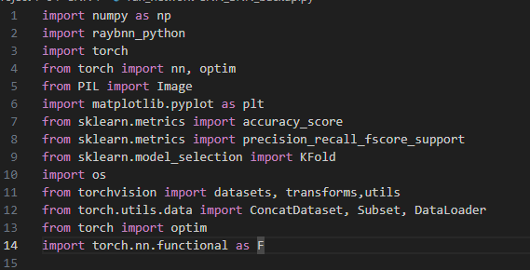

Prepare Dataset
Pip install necessary packages in the virtual environment
Set download=True to automatically download MNIST Dataset
Notes:
You need to pip install the necessary packages in the virtual environment and download the MNIST dataset in advance.
And You can set download=True in the code, and it will automatically download MNIST for you.

Slide 7
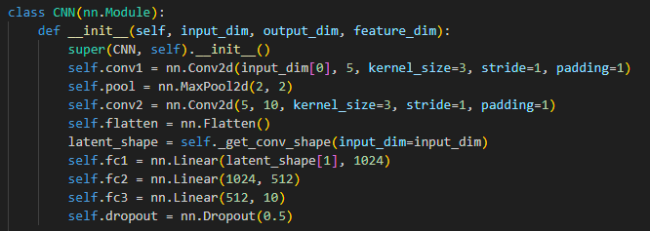
CNN module
layer setting
(I reduced kernel channel)
conv1: convolution layer with5 output channels, a kernel size of 3x3, stride of 1, and padding of 1.
pool: A max pooling layer with a kernel size of 2x2 and a stride of 2.
flatten: A layer that flattens the input
fc1: A fully connected (linear) layer
For extracted feature: image pixel -> conv1 -> pool -> conv2 -> flatten
Notes:
The CNN structure and layer settings are as follows:
For the extracted features, the data goes through conv1, pooling, conv2, and flatten layer before being returned as output.
I reduced the number of kernel channels in the convolutional layers to decrease the feature dimension. Otherwise, the feature dimension would be too large, requiring an excessive amount of memory.

Slide 8
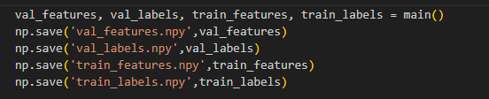
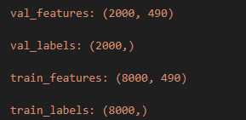
CNN output
Save output data
Check shape of features & labels after CNN
(# of samples set to 10000)
Original features dimension: 3136
Features dimension after modification: 490
Notes:
I modified the original Python file to save the features and labels so that we don’t need to train the CNN model again before RaybNN training.
Here is the shape of the features and labels after modification: I reduced the feature dimension from 3136 to 490.

Slide 9
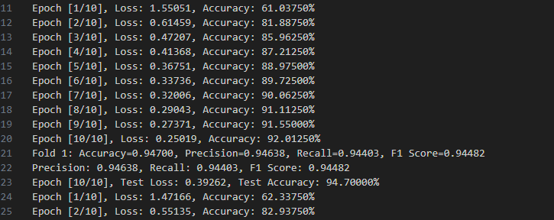
CNN output
The output during model training
K fold cross validation: k = 5 (the original is 10)
Epoch = 10
Notes:
This is the output during CNN model training. It uses k-fold cross-validation, and the number of epochs is set to 10.
You can see that the loss is getting lower and the accuracy is getting higher during the model training process. Currently, the accuracy is at 94%. I reduced the parameters to shorten the training time, which resulted in a slightly lower accuracy compared to the original, higher accuracy.

Slide 10
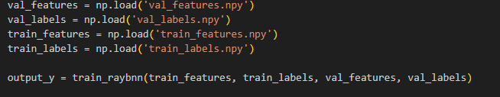
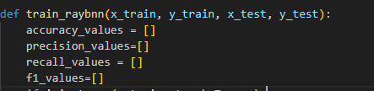
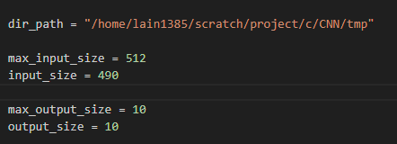
RaybNN training
Load saved data and invoke function train_raybnn
modify input_size to match CNN output in the function train_raybnn
Notes:
Then, the extracted features and labels need to be loaded and input into the RayBNN model to start training.
Please note that the input_size should be set to match your feature dimension.

Slide 11
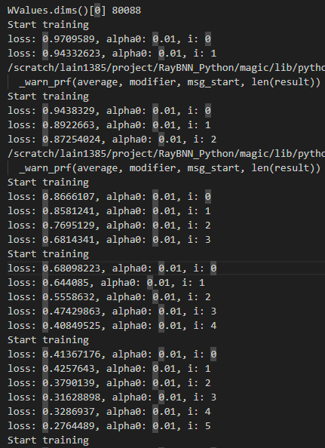
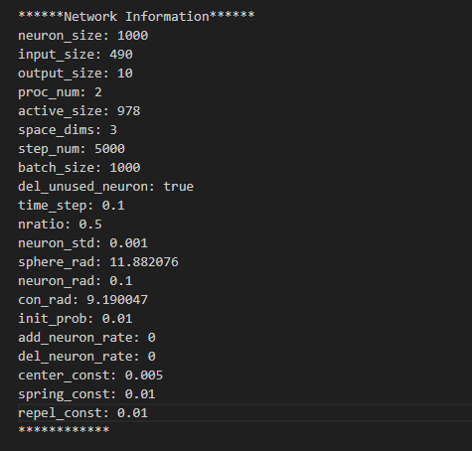
RaybNN training ouput
Parameters of RayBNN training
Loss during RayBNN training
Still working on how to improve performance
Notes:
Here is the output of RayBNN training. It first shows the parameters of the model, and then you can see the loss decreasing steadily during the training process.
I am sure that the CNN and RayBNN models are working properly, but I am still working on improving their performance.

Slide 12
Thank you

